Slide 1
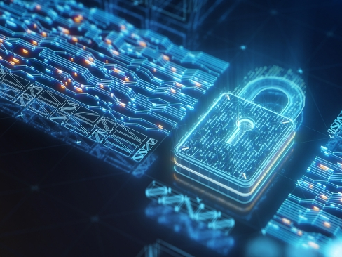
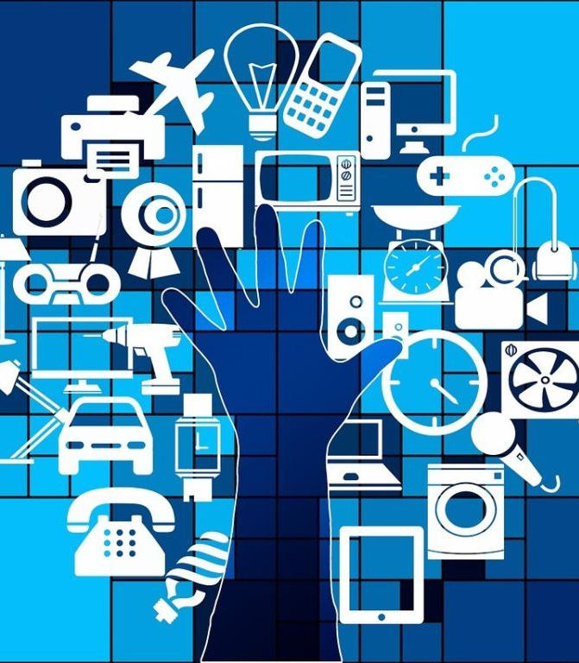
TrustChain: Establishing Trust in the IoT-based Applications Ecosystem Using Blockchain
Çağatay AKKAŞ \ Mehmet Hilmi EMEL

Slide 2
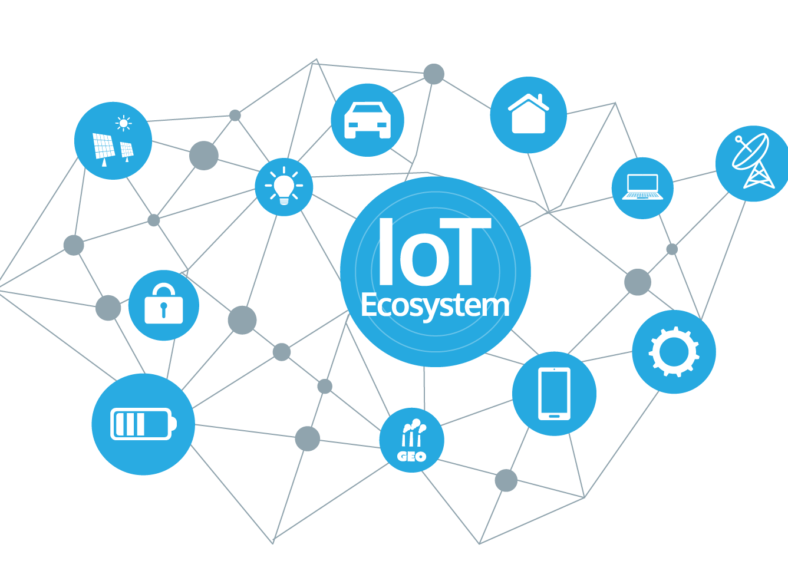
WHAT is IoT?

Slide 3
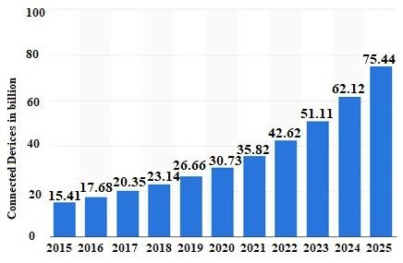
IoT Connected Devices from 2015 to 2025

Slide 4
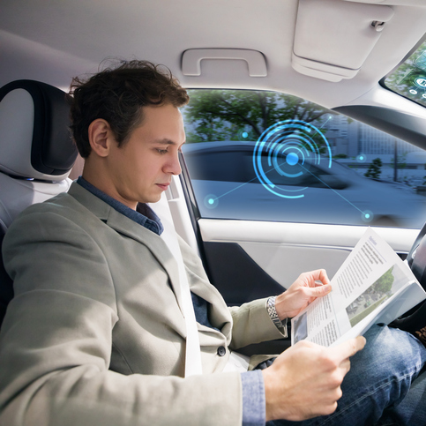
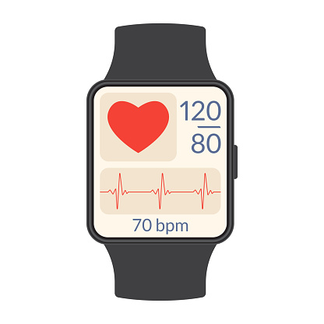
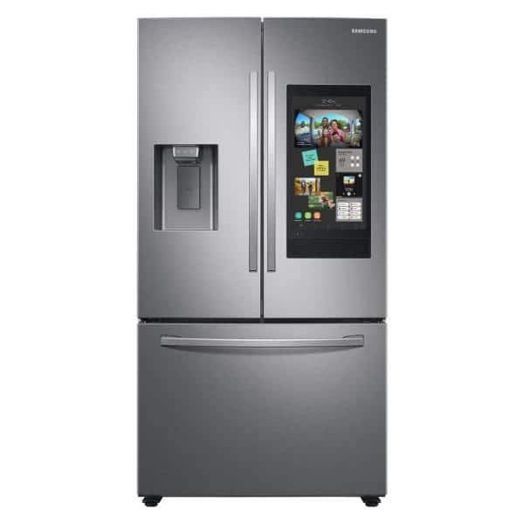

Slide 5
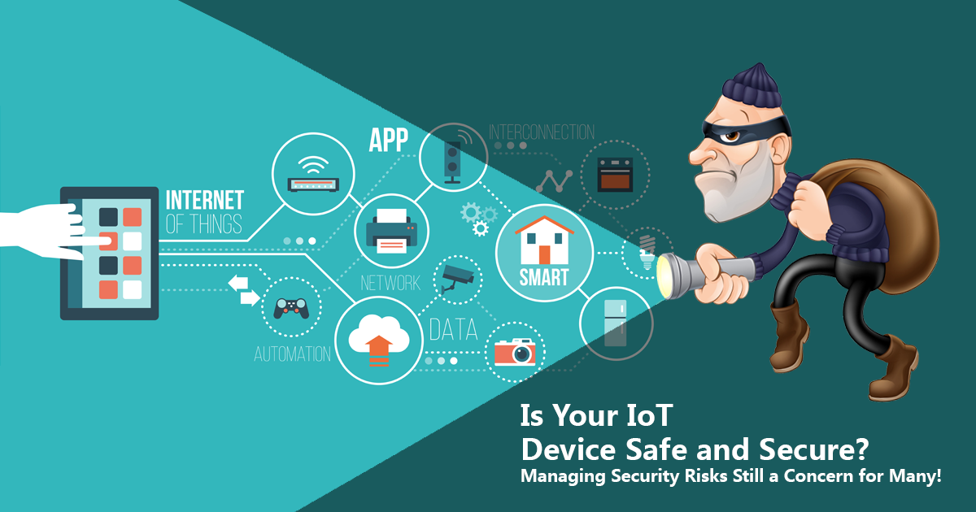

Slide 6




Slide 7
Some key challenges for building a trustworthy trading platform for IoT devices
Lack of trust among participating entities.
1
Lack of data supervision and management.
2
Lack of devices’ lifecycle management.
3

Slide 8
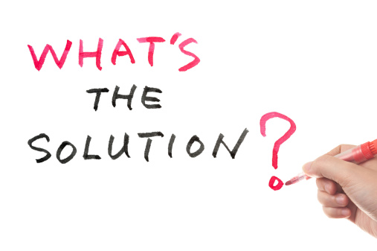

Slide 9
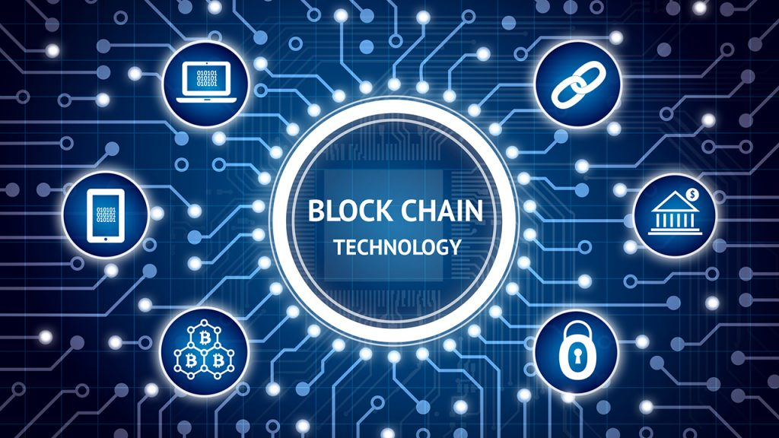

Slide 10
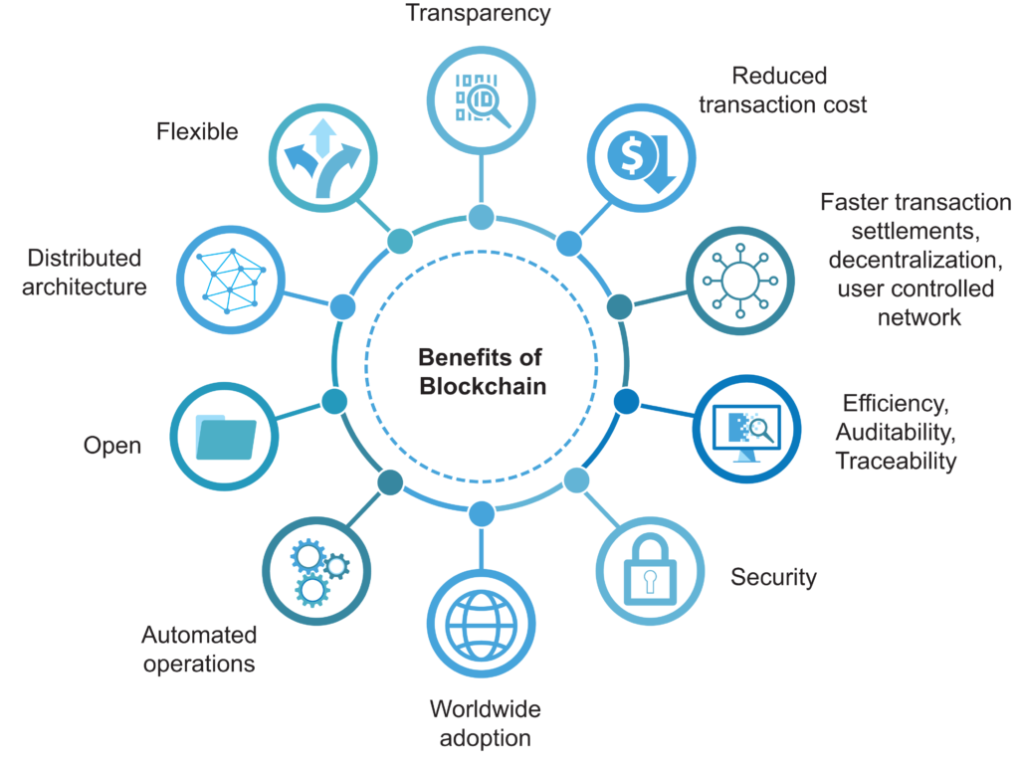
WHAT is Blockchain?

Slide 11
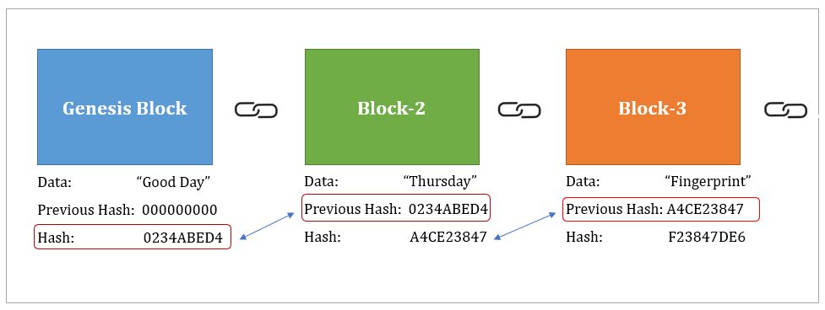
How it works?
-Modifying data changes hash and it breakes the chain.
-Enhanced security.
Can anyone break in?

Slide 12
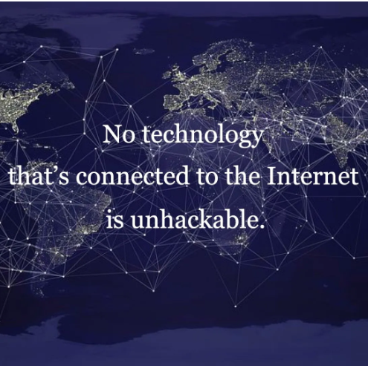
%51 Attack
When:
-If group of miners control +%50 of mining hash rate or computing power
What can it do:
-Reversing transactions.
-Can corrupt blockchain network.
-Steal or change the value of coins.
-Is blockchain even safe?

Slide 13
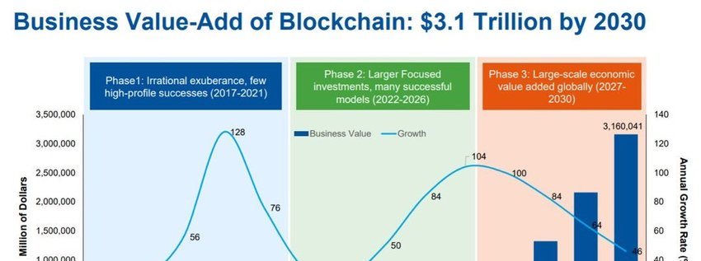
Can it happen?
Yes but no.
Bitcoin has over 1.000.000+ miners(2021).
Ethereum 400.000 + active miners(2022).

Slide 14
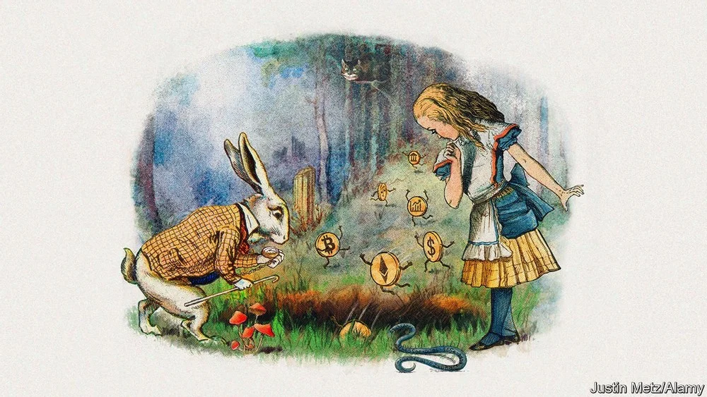
Transparency
-Data is available/visible to anyone , anytime.
-Trustworthiness is a key issue for any system.
Is it really what we want?

Slide 15
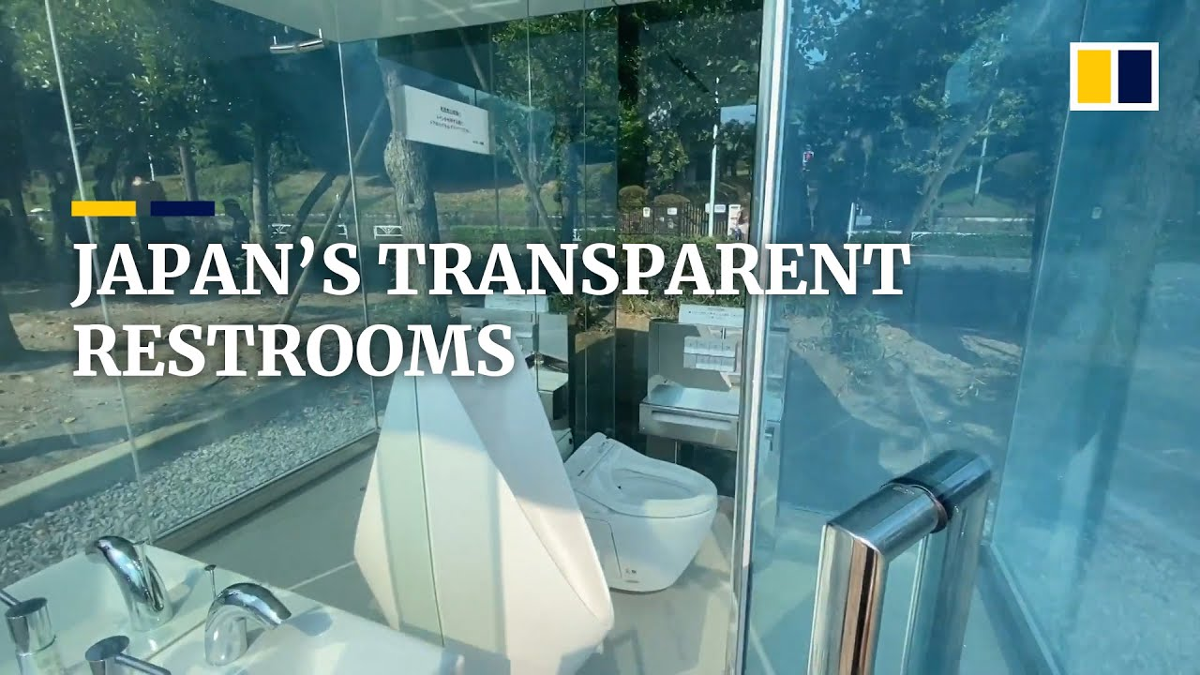
What will happen to our private data?

Slide 16
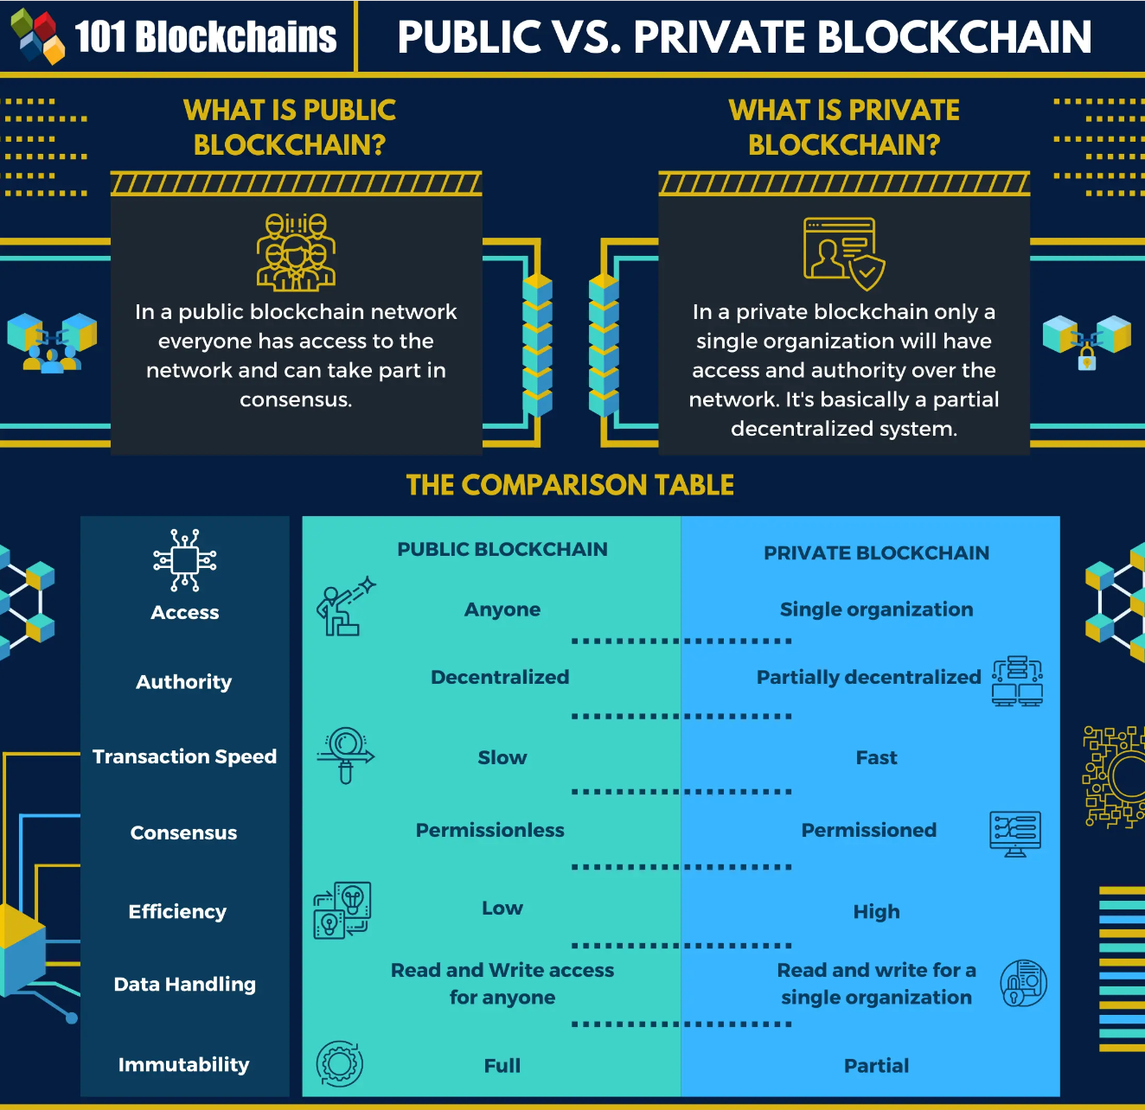
How can I trust single organization?

Slide 17
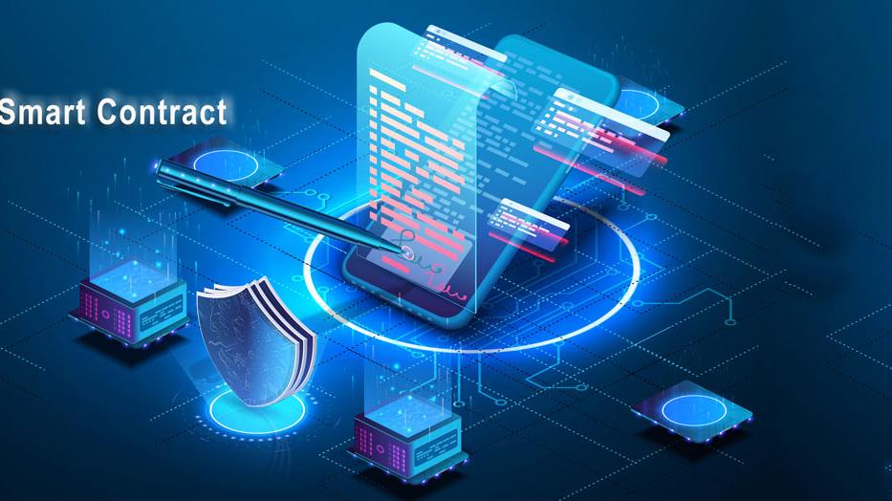
Smart Contracts
Encrypted and crytograph keep all documents safe -> Trustless environment.
-Automated tasks by using computer protocols
-> Fast action.
-Documents duplicate several times on blockhain
-> Can be restored in data loss.

Slide 18
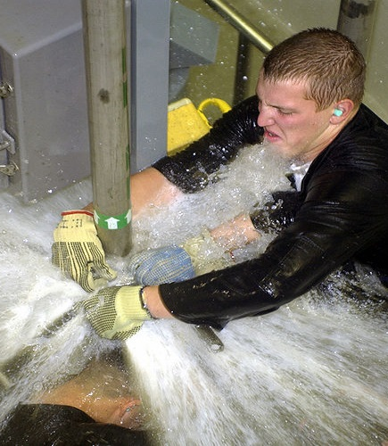
Problems of Blockchain
-Energy consumption:
-Scalability:Every device in network must have copy of every transaction = massive storage
-Regulation: Decentralization of authority
-> No moderators , laws or leaders.
-Cost:Any transaction on blockchain has cost.
-It is complex to understand and adopt .

Slide 19
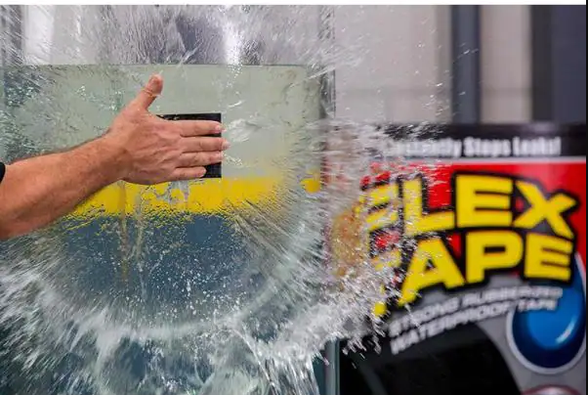

Slide 20

Problems which blockchain can resolve
-Voting
-Charity
-Crowdfunding
-Any kinds of luck based online system(lottery etc.)
-Government operations
-Supply chains (payment/logistic/taxes/trasporation information...)
-Removing intermediaries
-Copyright issues
-And many more...

Slide 21
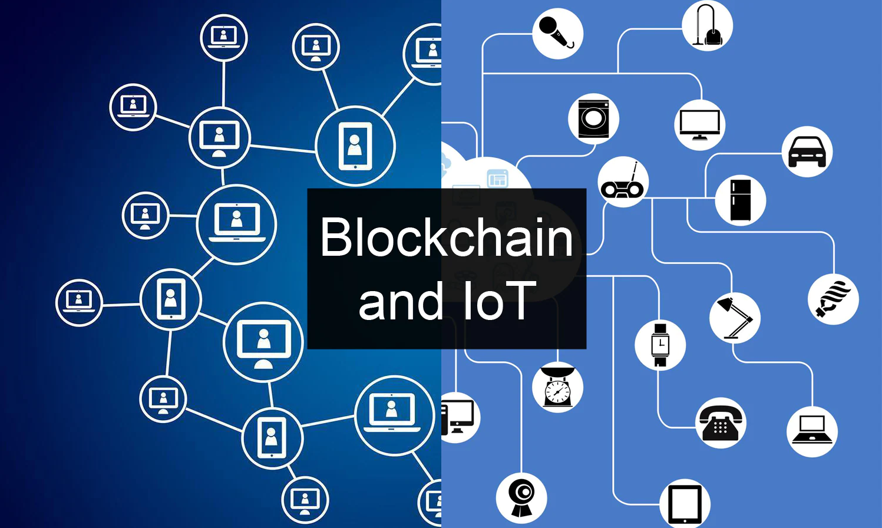

Slide 22
References
https://www.businessinsider.com/personal-finance/how-to-mine-ethereum
https://cybersophia.net/quotes/hacker-and-hacking-quotes-sayings
https://www.buybitcoinworldwide.com/how-many-bitcoins-are-there/#:~:text=How%20Many%20Bitcoin%20Miners%20Are,1%2C000%2C000%20unique%20individuals%20mining%20bitcoins
•https://www.washingtonpost.com/news/the-switch/wp/2018/06/19/verizon-will-suspend-sales-of-customer-location-data-after-a-prison-phone-company-was-caught-misusing-it/

